Slide 1





Project Presentation
VLAN and Inter-VLAN Routing with FortiGate

Slide 2

Our Team :
UNDER SUPERVISION :
Mohamed Ayman
DR. Hussein Harb
Mohamed Nader
ENG Alaa Elnemr
Osama Ahmed
Moaz Mahmoud

Slide 3


Introduction
  Overview: This project focuses on implementing VLANs (Virtual Local Area Networks) and inter-VLAN routing using FortiGate firewalls to enhance network security and efficiency.
  Background: VLANs allow logical segmentation of networks, while inter-VLAN routing enables communication between segments. FortiGate integrates firewall policies for secure traffic control.
  Importance: Essential for enterprise networks to isolate traffic, reduce broadcast domains, and prevent unauthorized access.
  Project Duration: 4 weeks, covering basics to advanced features.

Slide 4
Project Goals
  Primary Goals:
    Set up and configure VLANs on network switches.
    Implement inter-VLAN routing for communication between VLANs.
    Integrate FortiGate for secure routing and firewall policies.
  Expected Outcomes: A fully functional segmented network with documented configurations, diagrams, and testing reports.
  Benefits: Improved security, scalability, and performance in network environments.

Slide 5
Problems
1
2
  Common Challenges:
    Misconfiguration of VLAN trunks leading to traffic isolation.
    Firewall policies blocking legitimate inter-VLAN traffic.
    Routing issues like subnet mismatches or loops.
    Compatibility between switches and FortiGate interfaces.
  Potential Risks:
  Security vulnerabilities if policies are not properly set.
  Network downtime during testing.

Slide 6
Process
1
2
  Week 1: VLAN Basics – Create VLANs, assign ports, configure basic routing.
  Week 2: FortiGate Integration – Set up VLAN interfaces, routing, and firewall policies on FortiGate.
  Week 3: Advanced Features – Implement trunks, test communication, and troubleshoot.
  Week 4: Documentation – Compile reports, diagrams, and prepare presentation.

Slide 7
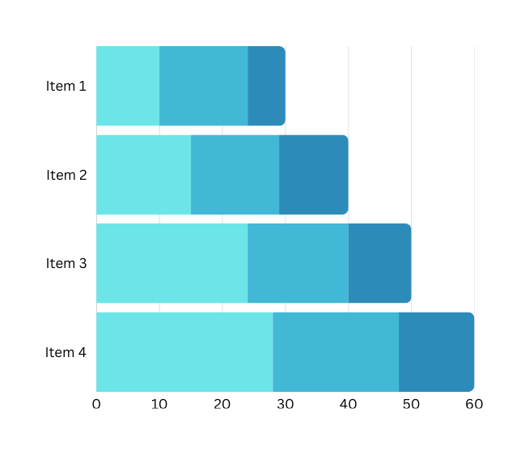
Result
  Achievements:
    Successfully configured VLANs (e.g., VLAN 5 and VLAN 10) with isolated traffic.
    Enabled inter-VLAN routing via FortiGate, allowing controlled communication.
    Implemented firewall policies to secure traffic (e.g., allow HTTP, block ICMP).
  Testing Outcomes:
    Inter-VLAN pings succeeded through FortiGate.
    Trunk ports handled tagged traffic correctly.
    No security breaches in simulated scenarios.

Slide 8
Conclusion
  Summary: The project demonstrated the effective use of VLANs and FortiGate for secure, segmented networks, achieving all goals through structured implementation.
  Key Learnings: VLANs reduce broadcast domains; FortiGate enhances security with policies; thorough testing prevents issues.
  Applications: Applicable in enterprises for departments like Sales and IT, or secure guest networks.
  Recommendations: Explore advanced topics like VLAN or integrate with SD-WAN for future projects.
  Final Note: This hands-on experience builds skills in network engineering and cybersecurity.

Slide 9
Q&A Session

Slide 10
Thank You

